Slide 1
Agile Development
Topic 6:
Project Management (Part 1 - Control, Risk)
Notes:
NCC Education - Title Master

Slide 2
Topic 6 Coverage
This topic will cover:
  Traditional project management compared with Agile project management;
  The control aspects of Agile project management;
  Risk in Agile project management;
  Part 2 of Agile Project Management, in Topic 7, will cover other aspects, in particular Quality and Testing.
Notes:
Traditional project management is much like the Waterfall approach in the sense that it is restricts creativity by setting rigid milestones and deadlines, whilst Agile project management allows projects to evolve more fluidly.

Slide 3
Agile Project Management
  Major Planning Issues
  Part 1:
    Control
    Risk
  Part 2:
    Configuration Management
    Quality
    Testing
    Metrics
    Maintainability

Slide 4


Traditional and Agile Project Management
Traditional offers strict adherence to specification; control of resource in order to hit time and budget for the fixed specification.
Agile is evolutionary; collaborative; has a ‘no-blame’ user/developer relationship; uses timeboxing to deliver a usable system on time.
Source: Image from pixabay.com © 2016
Notes:
The Traditional project management style allows very little collaboration across teams and is restrictive and regimental by nature. Whereas, the Agile project management style is free to evolve with the projects needs, invites collaboration and uses time boxing over rigid milestones without impacting on the final deployment deadlines.

Slide 5
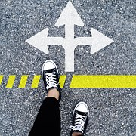
Exercise 1: Traditional vs Agile
Get into pairs. One of you is the Project Manager, the other one is the team worker.
Source: Image from pixabay.com © 2016
Notes:
Tutor to firstly tell the Project Manager to choose a destination in the room to act as and end point, but they must not tell the team worker where it is. They must give the team worker set instructions how to get there. Once all pairs have completed the task and reached the destination the tutor should tell the Project manager to pick a new destination in the room and to share it with the team worker this time. The team worker needs to then decide the best route to reach this destination themselves.
Get the pairs to discuss and feedback which approach was better and why.
Highlight that the Traditional way is harder, riskier and less satisfying than the Agile way.
The Agile way, whilst quicker, expects personal responsibility and a level of skill from the team worker.
DSDM ATERN
Modelling
ATERN S2 modelling

Slide 6
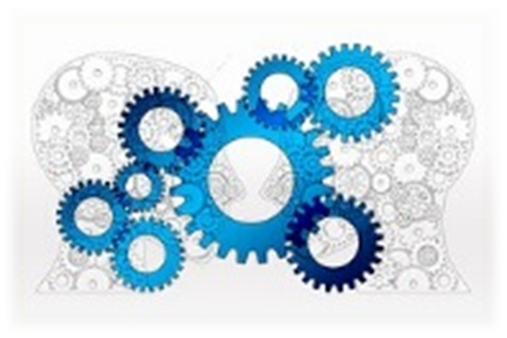
Agile Project Managers must:
Understand the business and technical issues
Facilitate the team (arbitrate not dictate)
Avoid ‘burnout’ of team members (allow sustainable pace)
Source: Image from pixabay.com © 2016
Notes:
Agile project managers need to be flexible in their approach and have a clear understanding of the business and technical issues surrounding the project. They need to facilitate the team and promote a collaborative, joined up approach where all participants are equals. They must ensure that the project is well managed with regards to time allocated to support the team and avoid burning out.

Slide 7

Communication
  Points to consider:
  An environment conducive to good communication
  Team members who are good communicators
  Co-located teams, where possible
  Daily “stand-ups”
  Facilitated workshops
  Modelling and prototyping
Source: Image from pixabay.com © 2016
Notes:
Communication must be factored in throughout the project. It is helpful if teams work closely together physically, but remote teams can work equally effectively if they communicate regularly. There should be regular meetings; facilitated workshops and opportunities for modelling to take place. Getting the communication right will build a strong team and project.

Slide 8
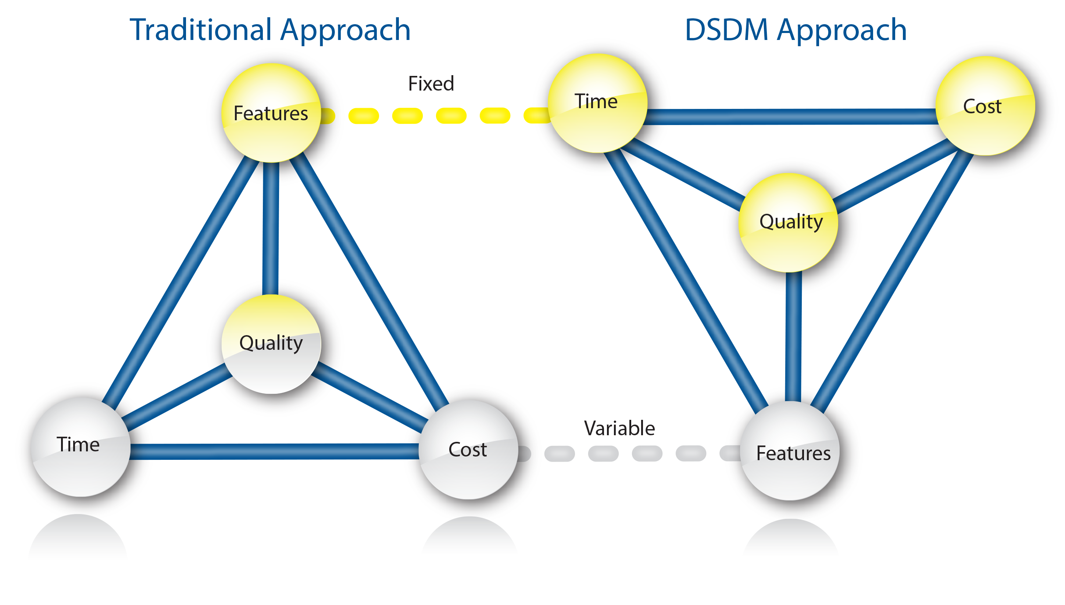
DSDM Atern Control Parameters
Source: Image from dsdm.org © 2016
Notes:
The inverted triangle is a strong DSDM concept: in a traditional waterfall project, the features would be fixed and this will often result in allowing time and cost to vary or in compromising quality. DSDM protects quality, time and cost by being flexible about features delivered, under the control of clear business prioritisation (MoSCoW prioritisation was covered in Topic 2).

Slide 9
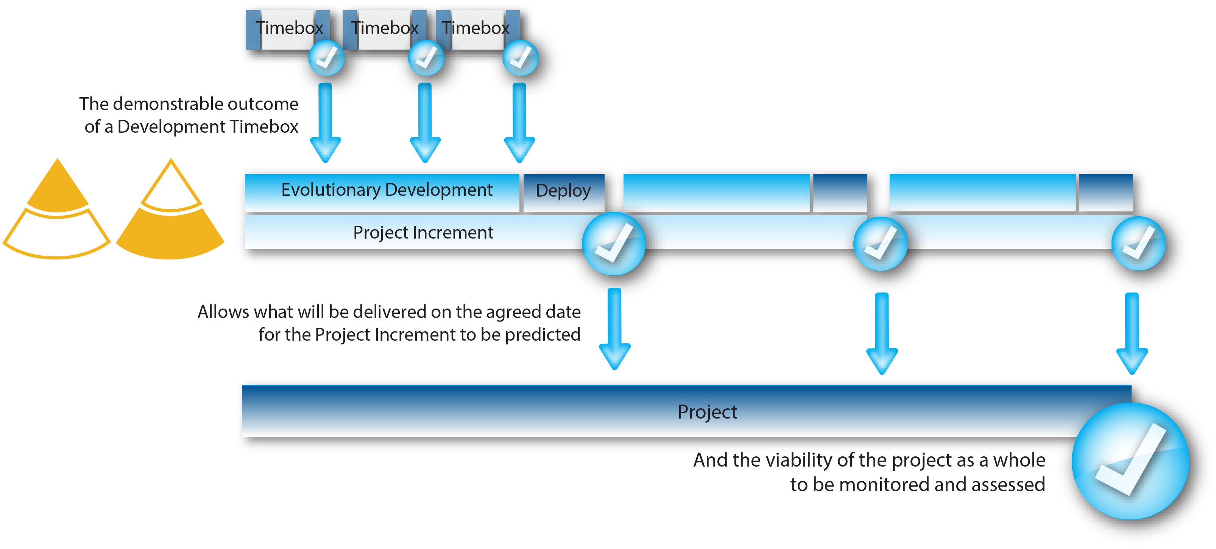
Planning in DSDM
Source: Image from dsdm.org © 2016
Notes:
The diagram shows how the DSDM Project Management process operates. Timeboxing allows for a more evolutionary development over a rigid milestone approach found in traditional approaches.

Slide 10

What is Risk?
A project risk is something that may happen during a project that will have a detrimental effect.
Source: Image from pixabay.com © 2016
Notes:
There are always risks in any project and these risks must be anticipated and contingencies put in place.

Slide 11
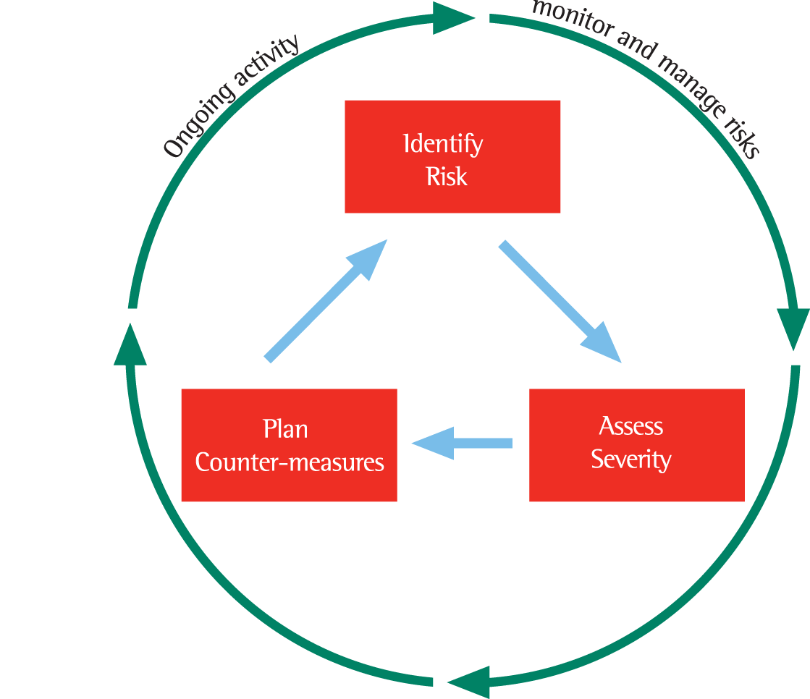
A Typical Risk Management Process
Source: Image from dsdm.org © 2016
Notes:
Project Approach Questionnaire is a way to identify risks. All risks identified must be assessed and contingencies put in place. Risks should be continually monitored to manage the risk effectively.

Slide 12
Where DSDM Reduces Risk
  Traditional approaches use time contingency to reduce risk. Some Agile projects use NDUF (no design up front) and Traditional projects use BDUF (big design up front).
  DSDM uses the EDUF (enough design up front) approach. It is because requirements are sometimes unknowable up front or are likely to change during the project.
Notes:
Reduction of risk is often linked with the quantity of analysis and design work undertaken “up front” in the project. Some Agile approaches advocate the idea of not wasting time on “up front” work (hence NDUF - no design up front); waterfall is well-known for BDUF (big design up front); DSDM advocates doing enough design up front (EDUF) in order to mitigate the risk of rework due to lack of understanding of the project area, whilst retaining the competitive advantage of delivery of some benefit early, and benefit delivery frequently because of incremental development and delivery.

Slide 13
Risks to Agile Projects
  Points to consider are:
    Low/patchy business roles
    Fully-detailed specification
    100% solution expected
    Swapping team resources in and out.
Notes:
The risks specifically related to the use of DSDM are associated with things which must change from the waterfall culture: the involvement throughout of the right business people; the need for flexibility of prioritised requirements; the acceptance by the business that the control is exercised on time and cost, and quality is retained, by de-scoping lower-priority requirements.
There is a link between risks and the Project Approach Questionnaire, completed during the feasibility phase and revisited throughout the project.

Slide 14

Exercise 3: The three control parameters of cost, time and features
Get into groups of about 6. In your groups list 20 features you need in a house.
Source: Image from pixabay.com © 2016
Notes:
Class Exercise: The three control parameters of cost, time and features
This exercise may be run during or at the end of the lecture. Its purpose is to illustrate the idea of prioritising features to stay on time and budget
Divide the class into groups of six
Each group lists (on a flipchart or board) 20 features they need in a house (e.g. roof, walls etc but can be as “wild” as plasma TV, spa-pool etc.)
Having listed these, the tutor then advises that only half of these will be possible, within the budget. The group then must decide which are essential and which should be dropped.
Teaching points:
Hard to prioritise without a clear objective
Need to know if we will ever get the ones we de-scope.
Different people within the group have different priorities
We often identify more requirements than we really need
DSDM ATERN
Modelling
ATERN S2 modelling

Slide 15
Summary 1
  Agile Project Management (Part 1):
  Traditional project management compared with Agile project management
    Traditional project management is rigid and prevents creative thinking and strong collaboration. Agile Project Management allows for creative thinking with communication at the heart of the project.

Slide 16
Summary 2
  The control aspects of Agile project management
  Risk in Agile project management - Risks are identified and monitored and the timeboxing process in Agile Project Management allows for contingencies to be implemented more flexibly.
  Part 2 of Agile Project Management, in Topic 7, will cover other aspects, in particular Quality and Testing.

Slide 17
Topic 6 – Project Management (Part 1 - Control, Risk)
Any Questions?
Notes:
NCC Education - End Slide Master

